Slide 1

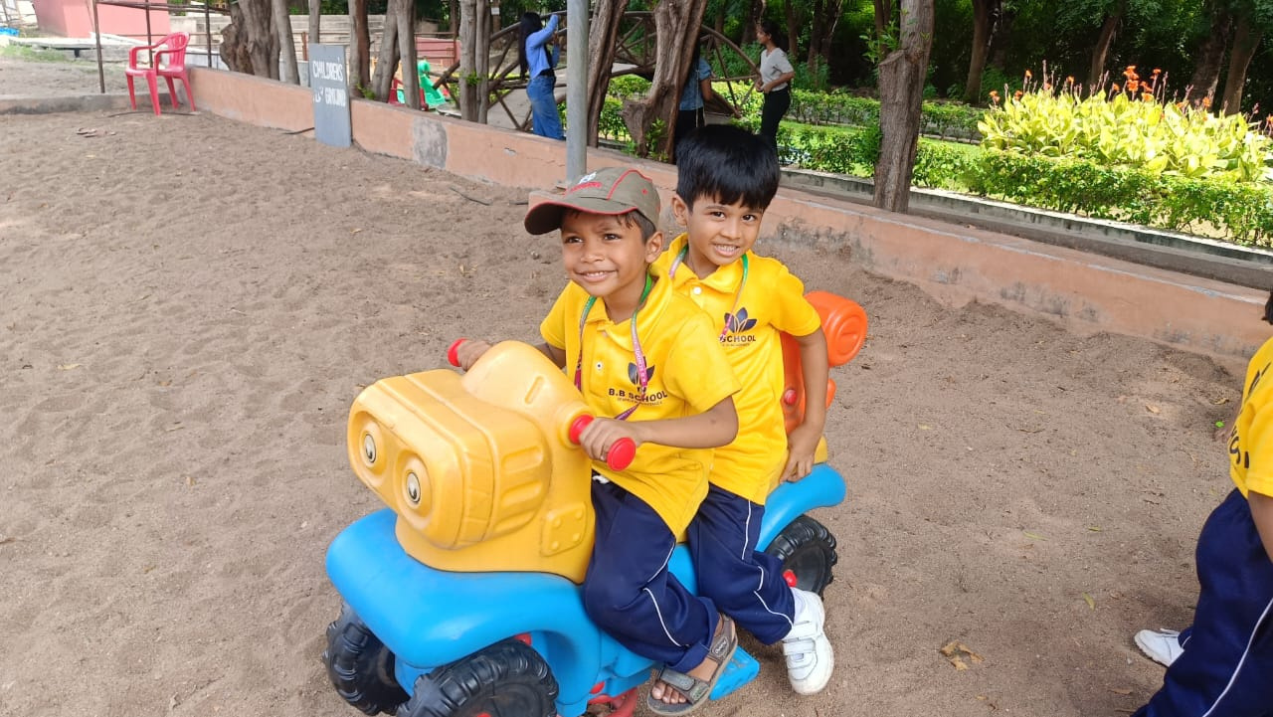



NURSERY TO GRADE VII
Where every child's dream takes its first flight
Where every child's dream takes its first flight

Slide 2
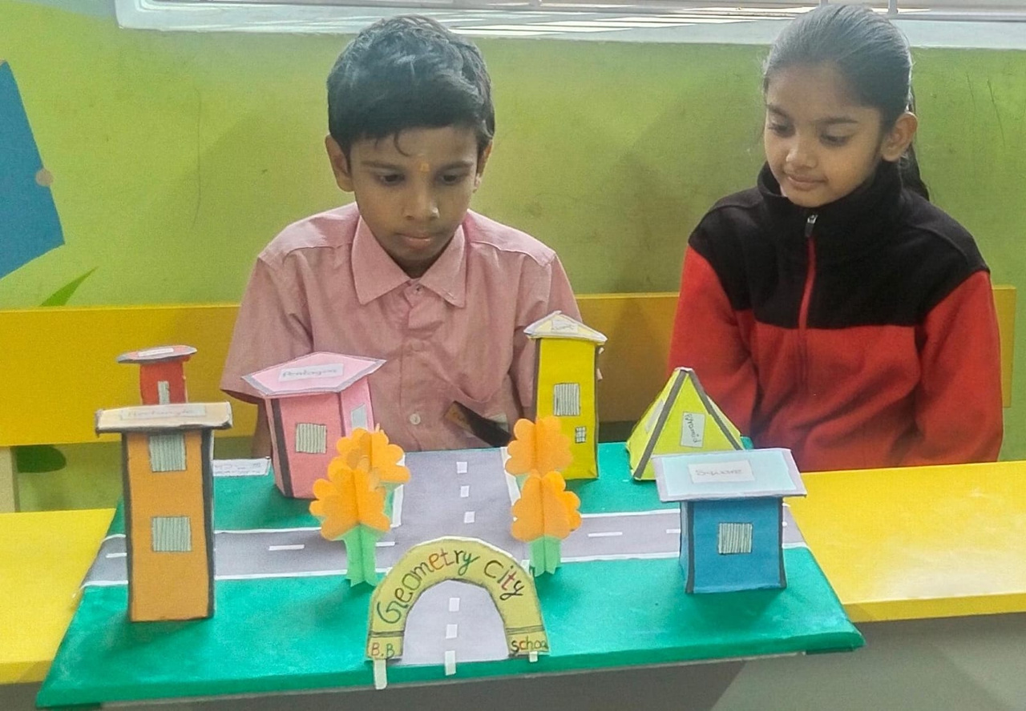
OUR VISION & MISSION
Our Vision:
To be a trusted educational institution guided by the principles of Panchpadi that shapes confident, compassionate, and competent learners for a changing world.
Our Mission:
Deliver holistic education rooted in strong values
Inspire curiosity, creativity, and lifelong learning
Nurture every child’s academic, emotional, and social growth
Create a safe, joyful, and future-ready learning environment

Slide 3
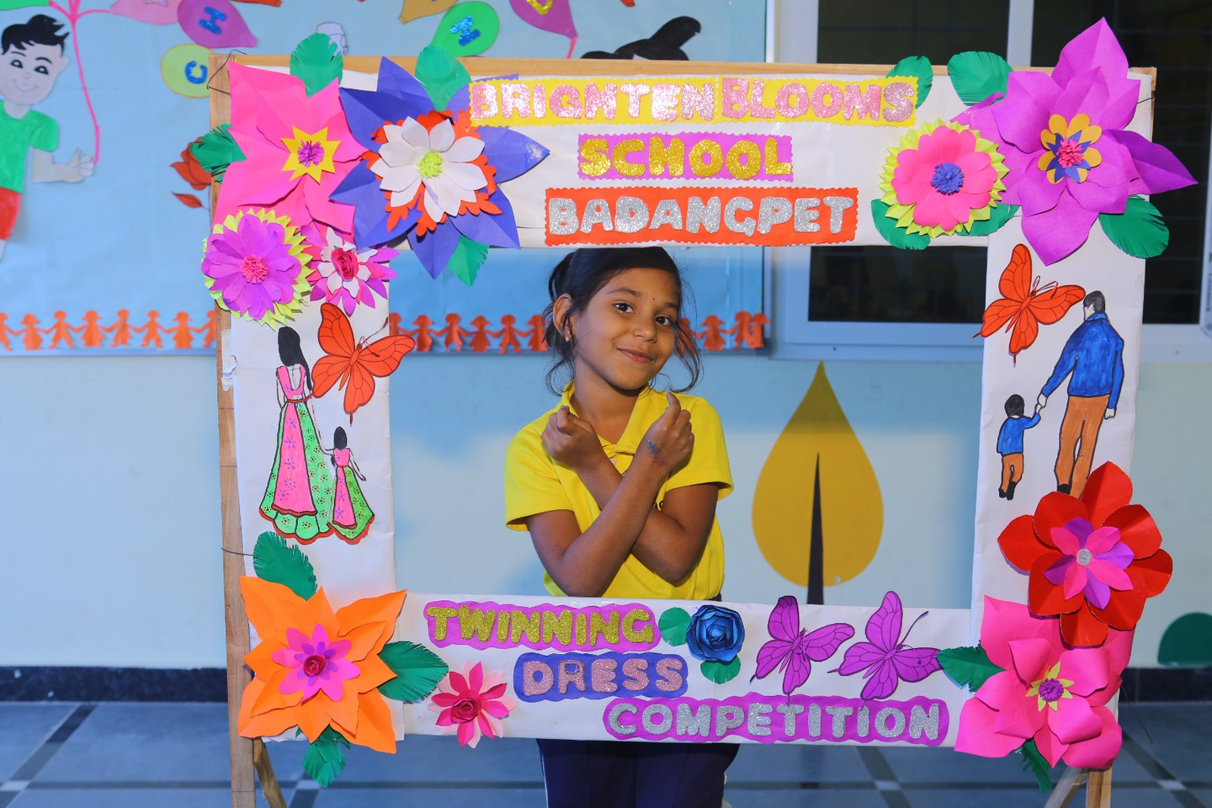

Why Choose Brighten Blooms School?
Qualified, experienced, and dedicated faculty with a child-centric approach
Strong academic foundation integrated with value-based education
Activity-based, experiential, and joyful learning methodologies
Personalized attention to nurture and unlock every child’s potential
Safe, secure, and well-equipped campus with modern learning facilities
Continuous parent–school partnership through transparent communication

Slide 4
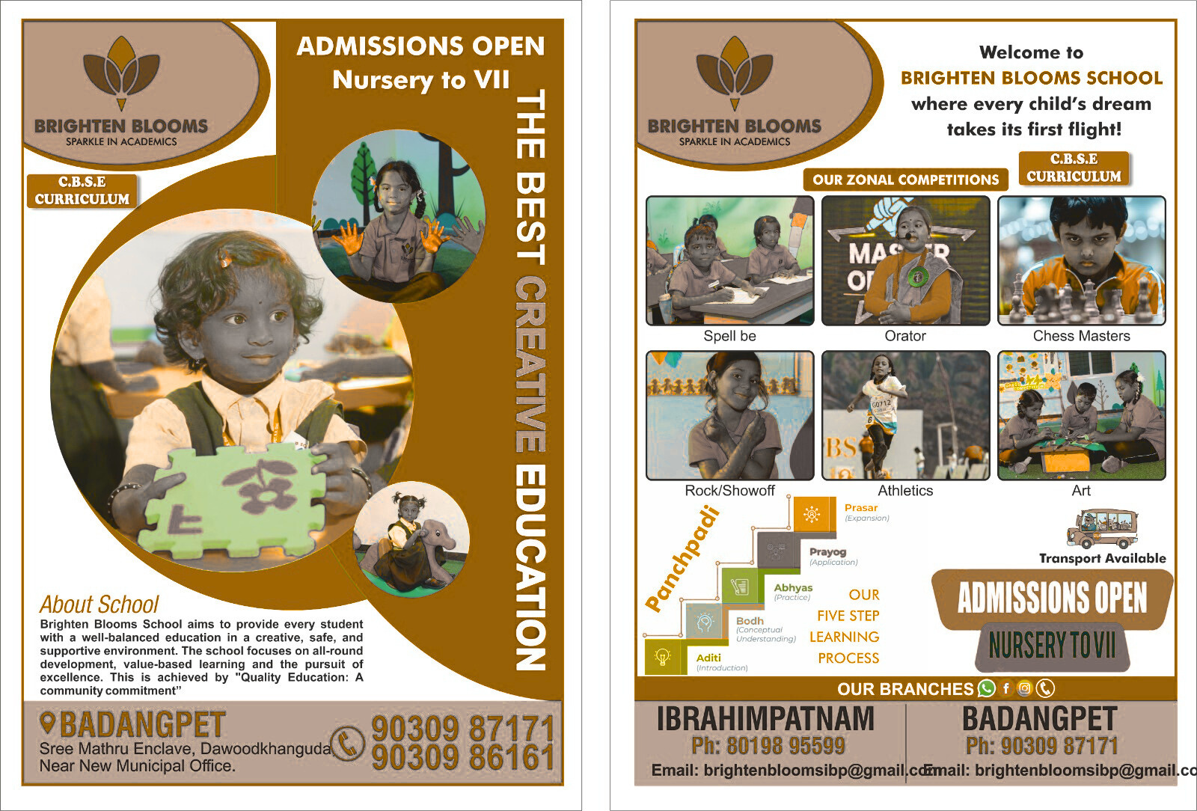
NURSERY TO GRADE VII
CBSE CURRICULUM
Where every child's dream takes its first flight
Where every child's dream takes its first flight

Slide 5
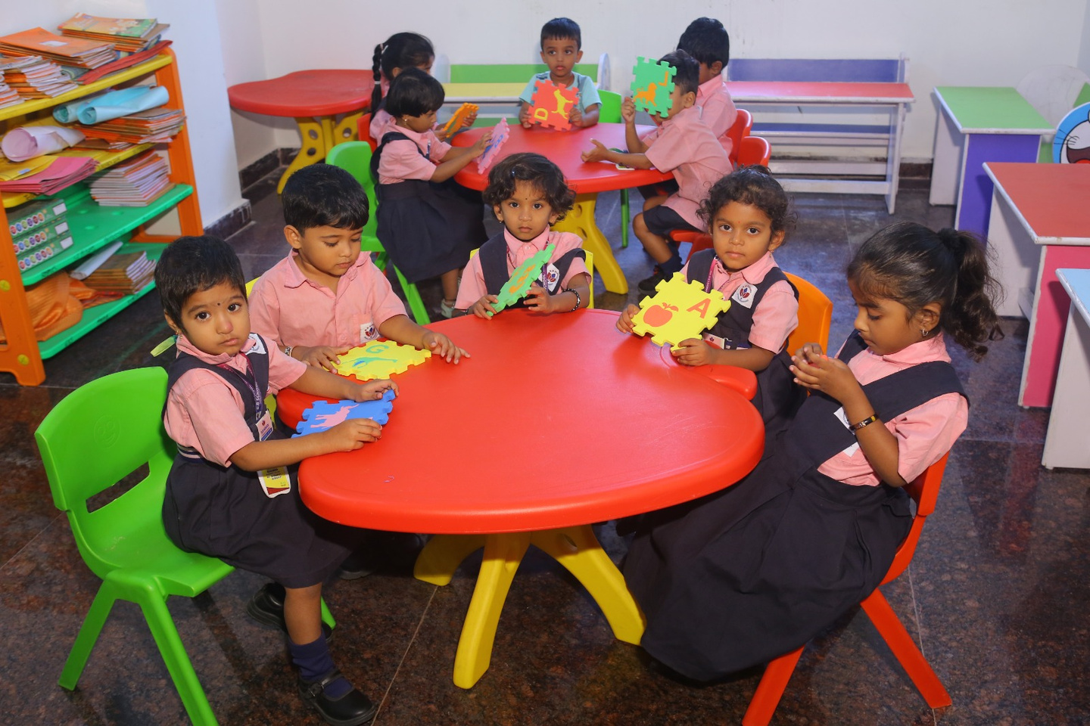

Academics
Zonal Competitions
Sports
What is BB School?
Safety & Well Being
Co-Curricular Activities
Personality Development
Life Skills

Slide 6

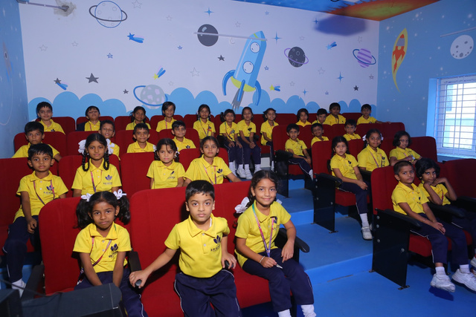
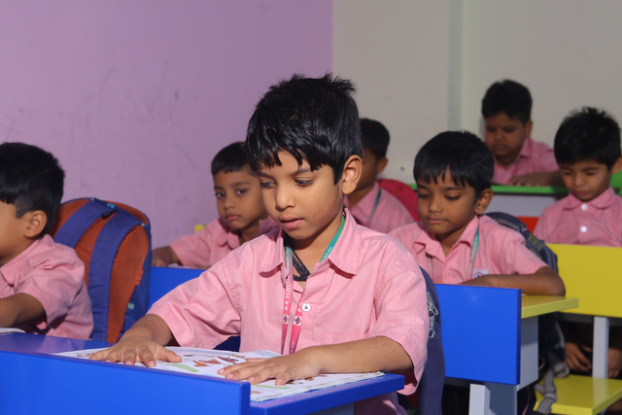
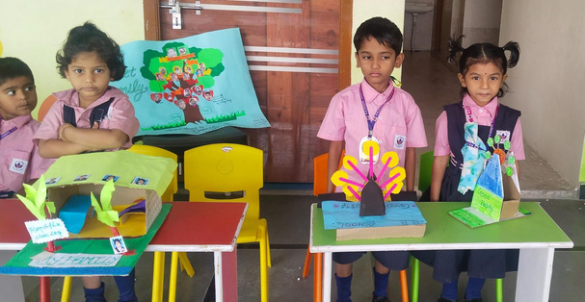
What is BB School?
BB School is a holistic learning institution focused on academic excellence, character building, and all-round development. We nurture young minds through innovative teaching, strong values, and a supportive environment that prepares students for future challenges.

Slide 7
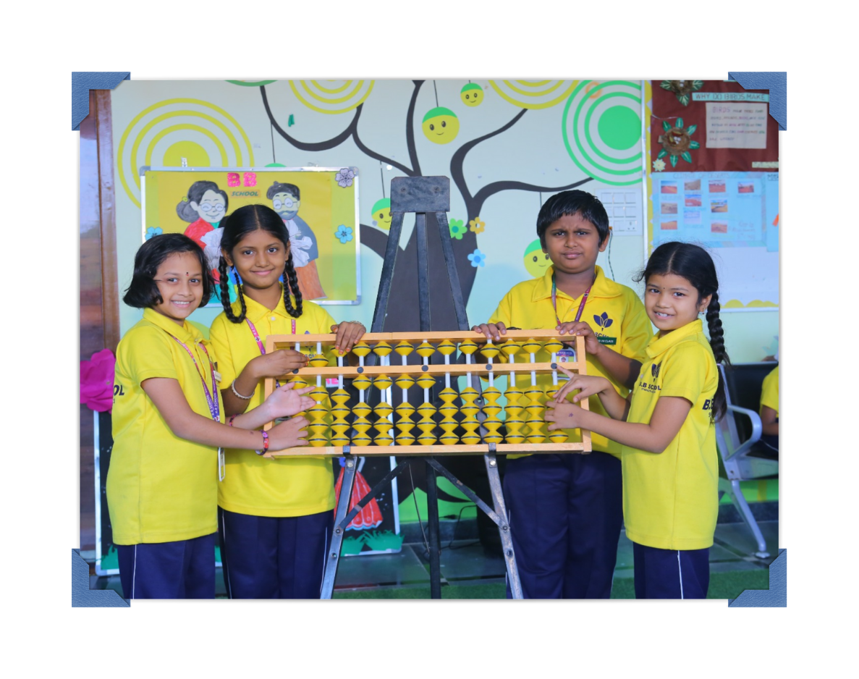
Abacus @ BB
The Abacus program at BB School strengthens students’ mental arithmetic, concentration, and problem-solving skills.
Enhances mental math skills
Improves concentration & memory
Builds confidence in numbers

Slide 8
Orator @ BB
The Orator program focuses on developing effective communication and public speaking skills. Students are encouraged to express their thoughts clearly, confidently, and creatively, helping them build leadership qualities and self-confidence from an early age.
Builds communication skills
Encourages confident expression
Develops leadership qualities

Slide 9
Spell Bee @ BB
Spell Bee activities at BB School improve vocabulary, spelling accuracy, and language proficiency. These engaging competitions enhance students’ listening skills, word recognition, and confidence while fostering a love for the English language.
Enhances vocabulary & spelling
Improves language skills
Encourages healthy competition

Slide 10
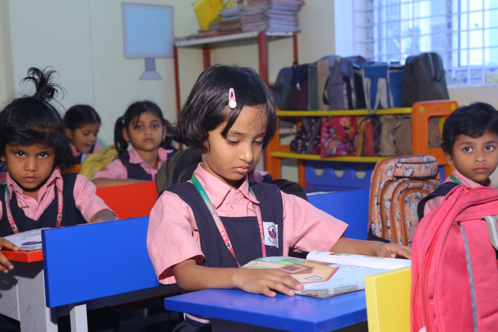
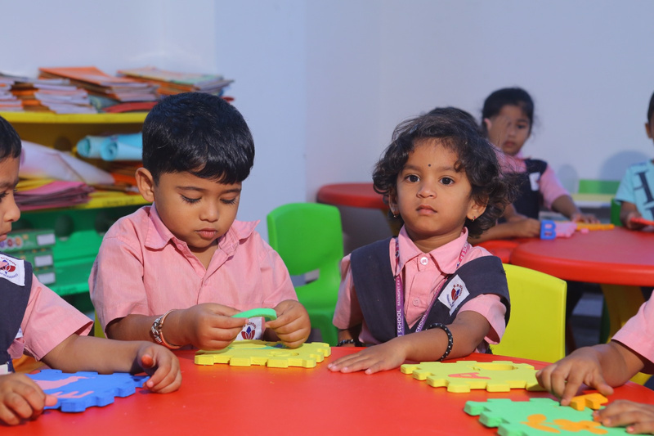
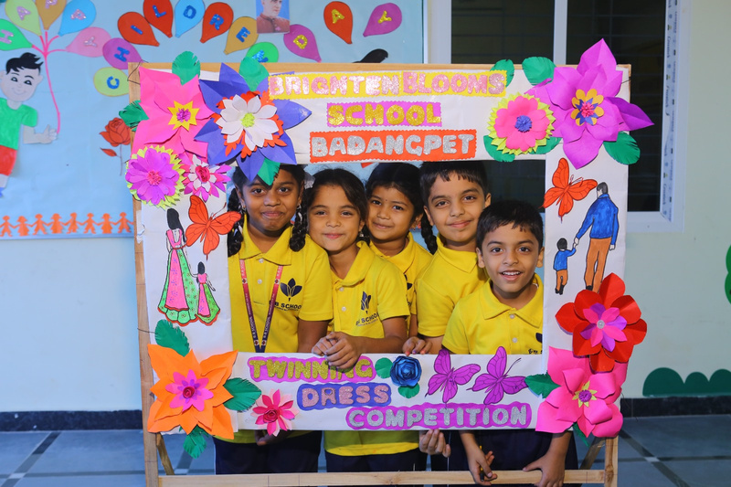
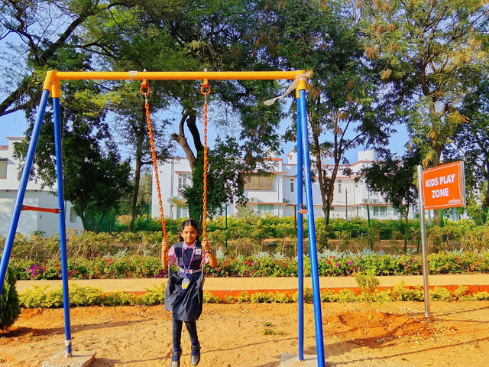
Life Skills
BB School emphasizes essential life skills including problem-solving, decision-making, communication, time management, and emotional intelligence. These skills help students’ become independent, responsible, and adaptable individuals.

Slide 11
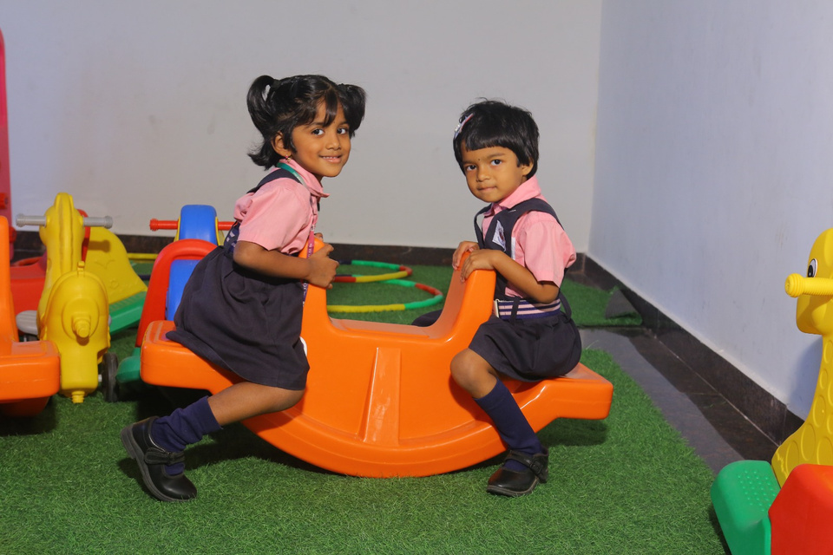
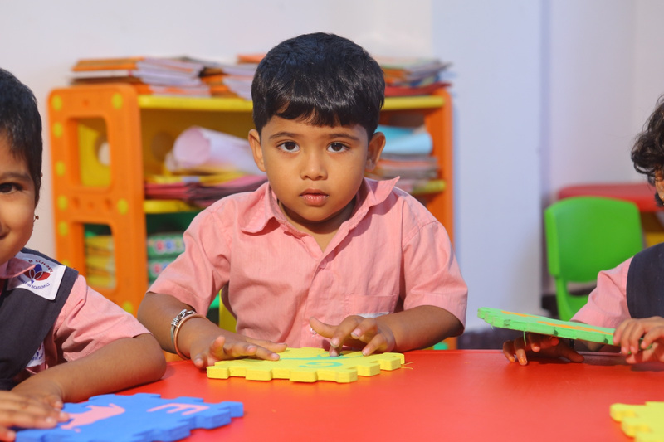
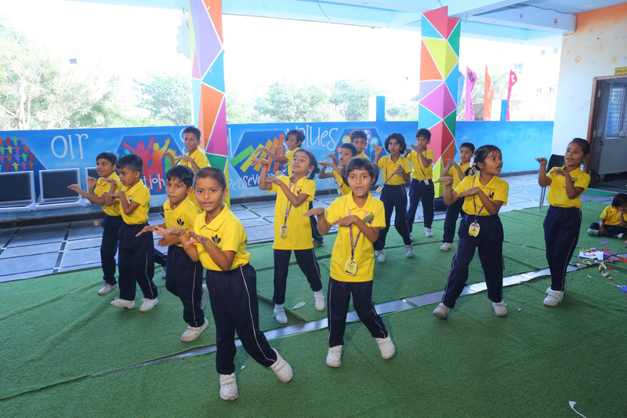
Personality Development
Through workshops, assemblies, leadership programs, and interactive sessions, BB School focuses on building self-confidence, positive attitude, public speaking, and leadership qualities to shape well-rounded personalities.

Slide 12
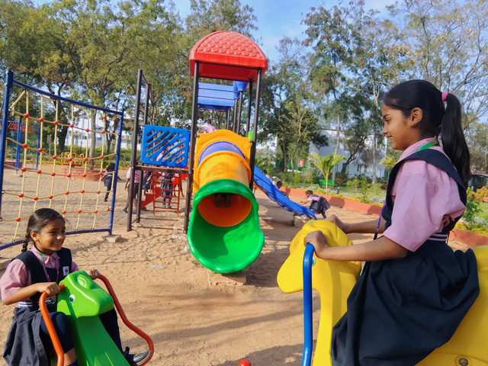
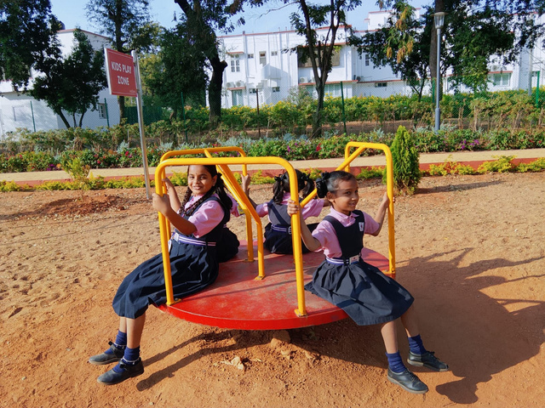
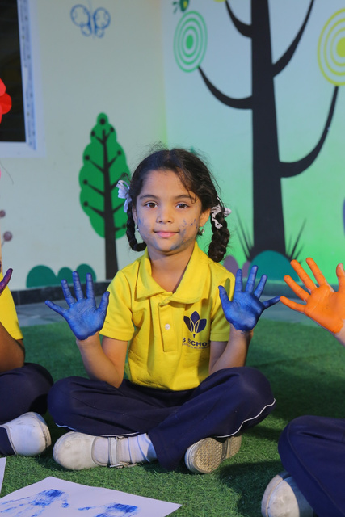
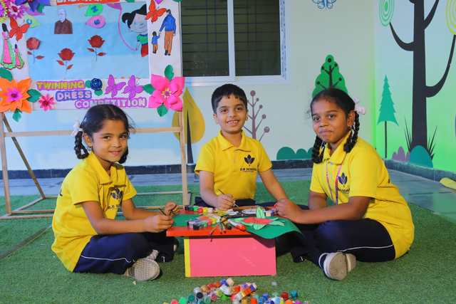
Co-Curricular Activities
Co-curricular activities such as arts, music, dance, drama, debates, and clubs provide students’ with creative expression and skill development. These activities enhance confidence, communication skills, and overall personality growth.

Slide 13
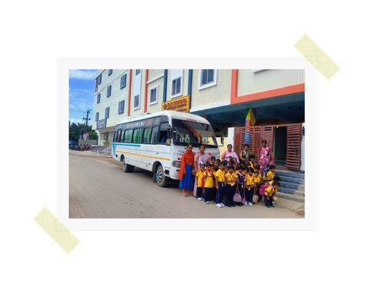
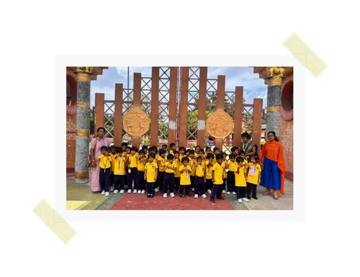
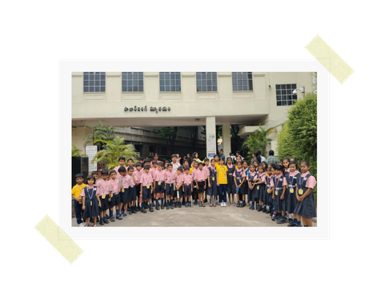
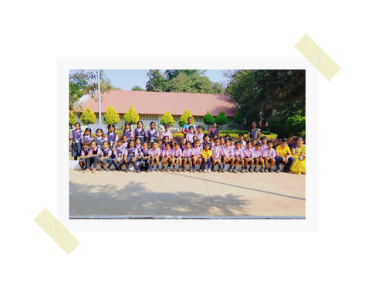
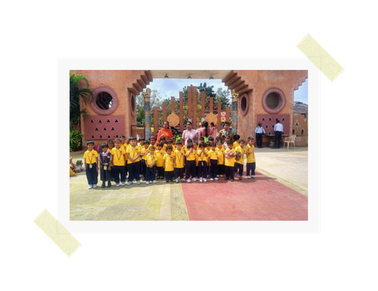
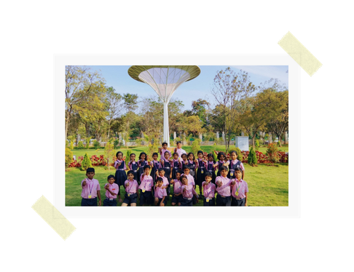
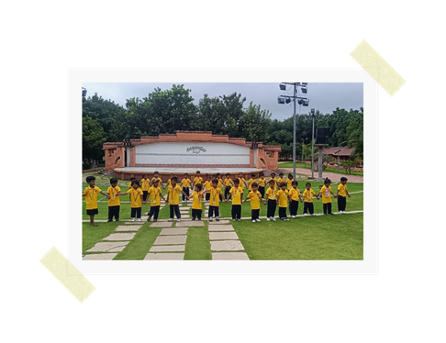
Field Trips
Field trips at BB School are designed to enhance learning beyond the classroom. These educational visits provide students’ with real-world exposure, practical knowledge, and experiential learning opportunities.

Slide 14
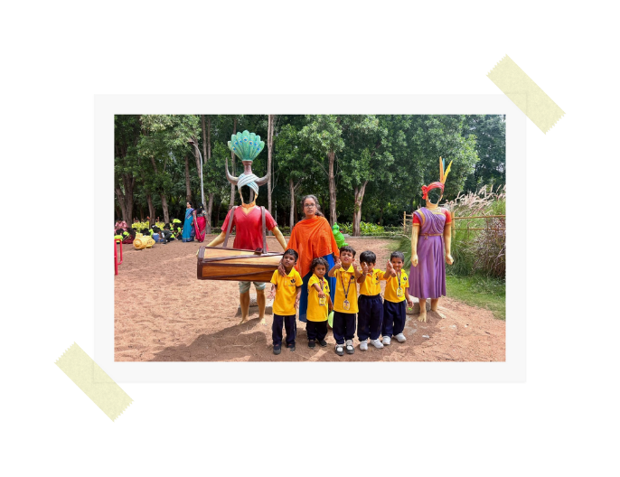
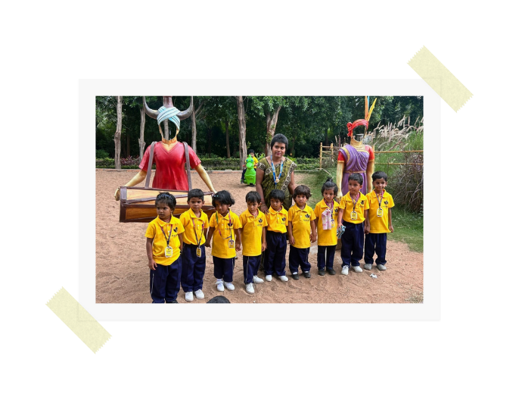
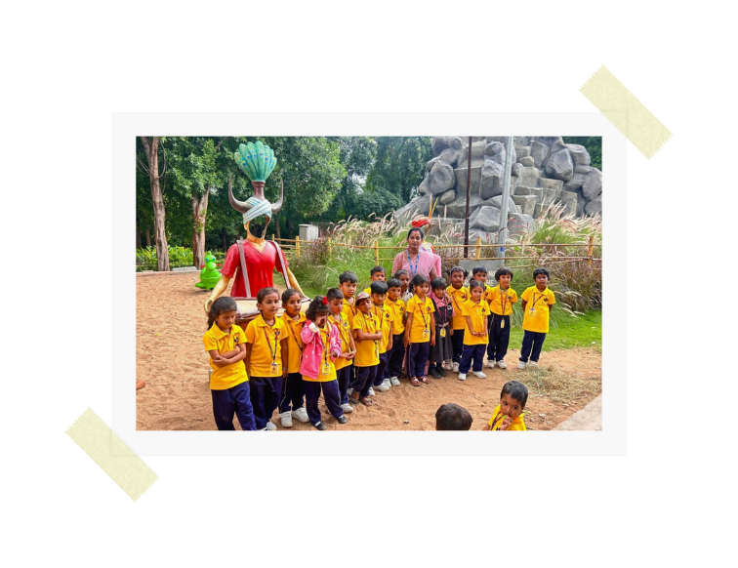
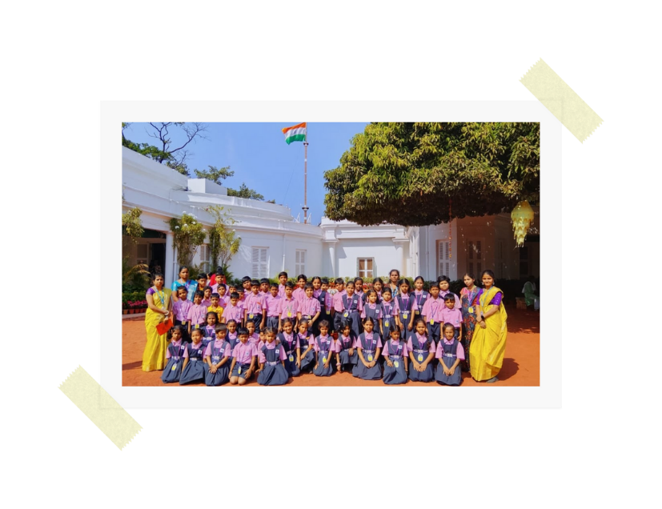
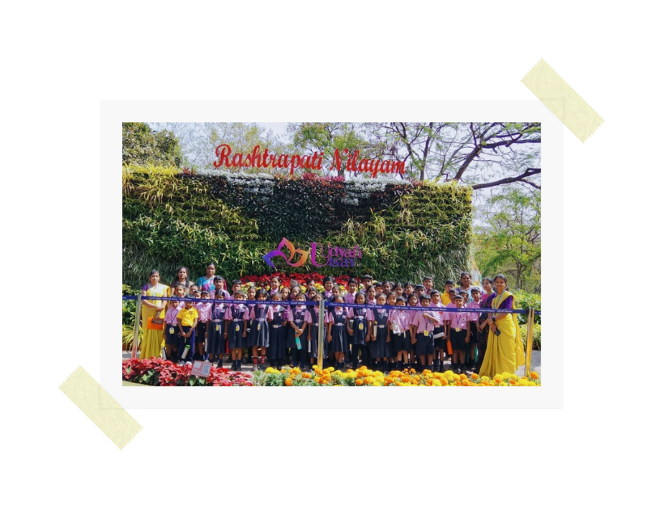
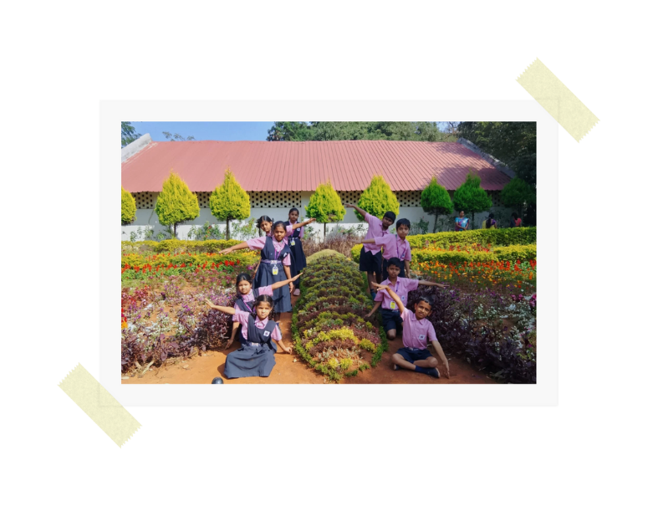
Field Trips

Slide 15
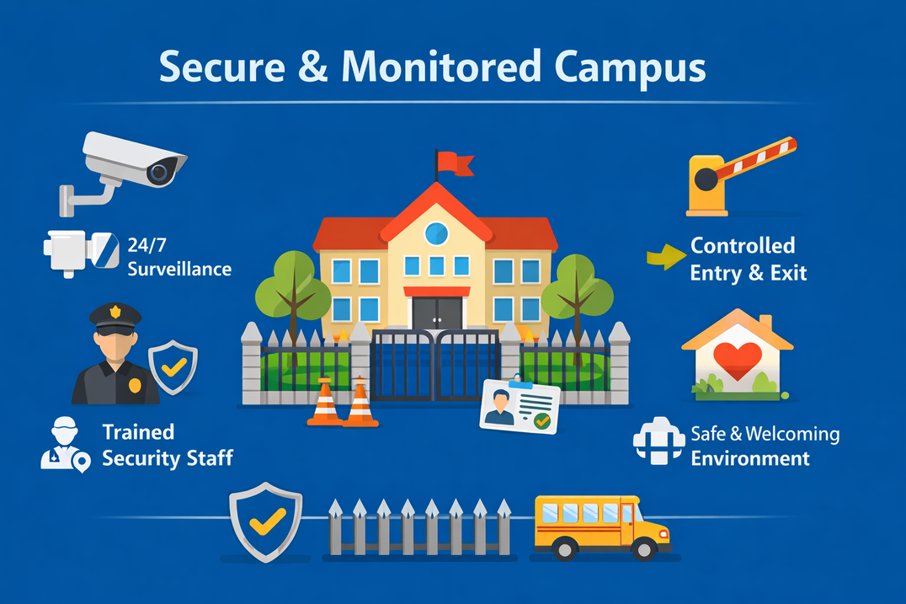
Safety & Well-Being
Student safety and well-being are our top priorities. BB School provides a secure campus, trained staff, health awareness programs, and a caring environment that supports students’ physical, emotional, and mental well-being.

Slide 16
Thank You

